Slide 1
Development and Push Deployment of Azure Functions using CLI and PowerShell
-Nikkitha Ramesh

Slide 2
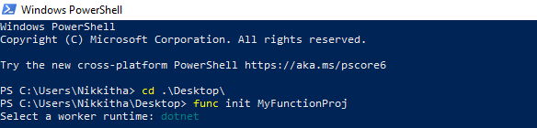
Create a function app locally. The function app is a single unit of deployment. Azure CLI will generate the necessary config files of the function app.

Slide 3
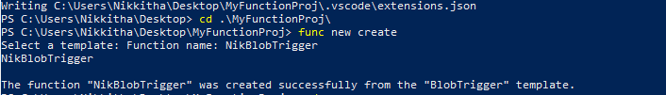
func new create is a command to create a new function.
It auto-generates all the settings files.

Slide 4
This displays the contents of the function app folder in Visual Studio Code.

Slide 5
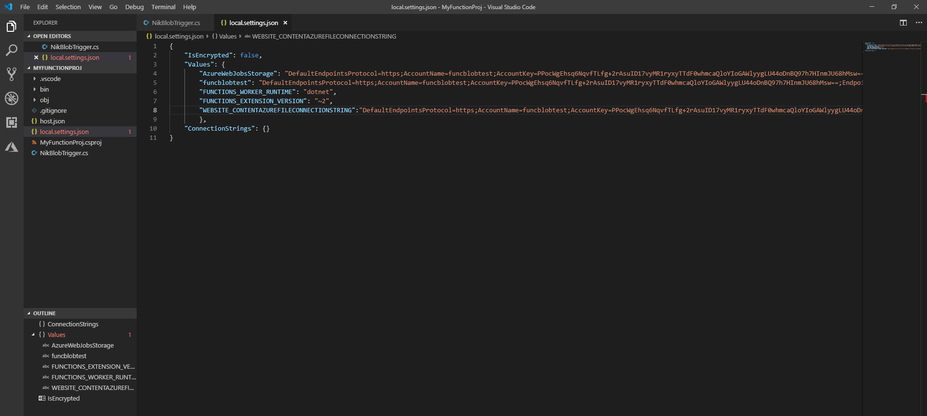
Add the connection string.

Slide 6
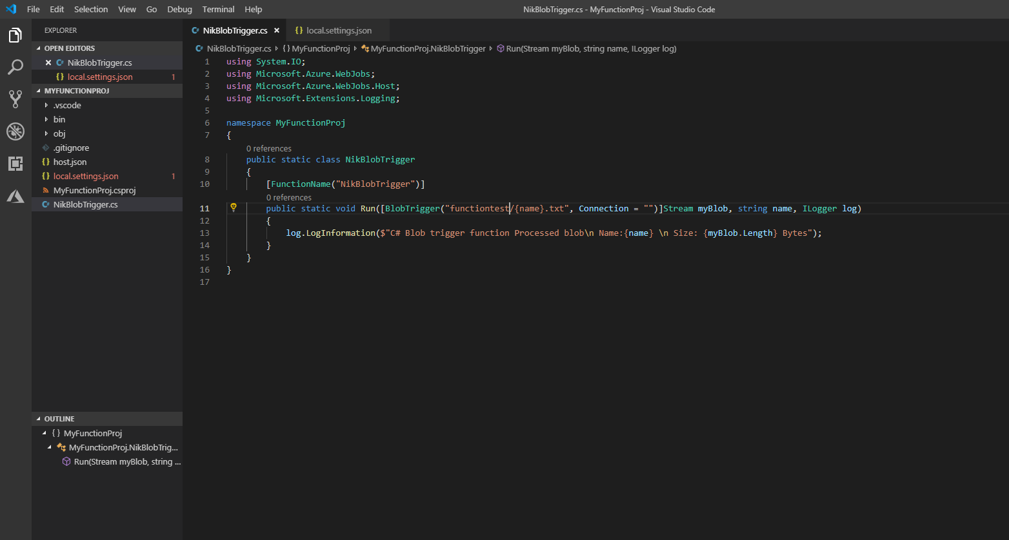
functiontest is the name of the blob container. The function only listens for .txt files coming into azure blob storage.

Slide 7
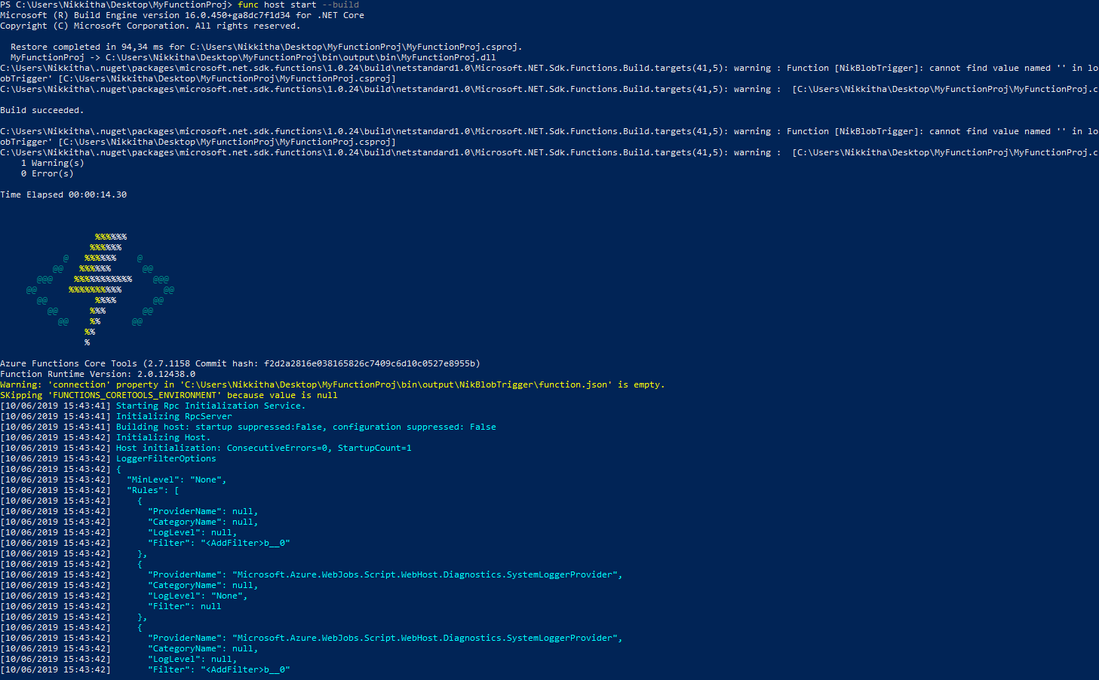
Func host start --build is used to compile and run.

Slide 8
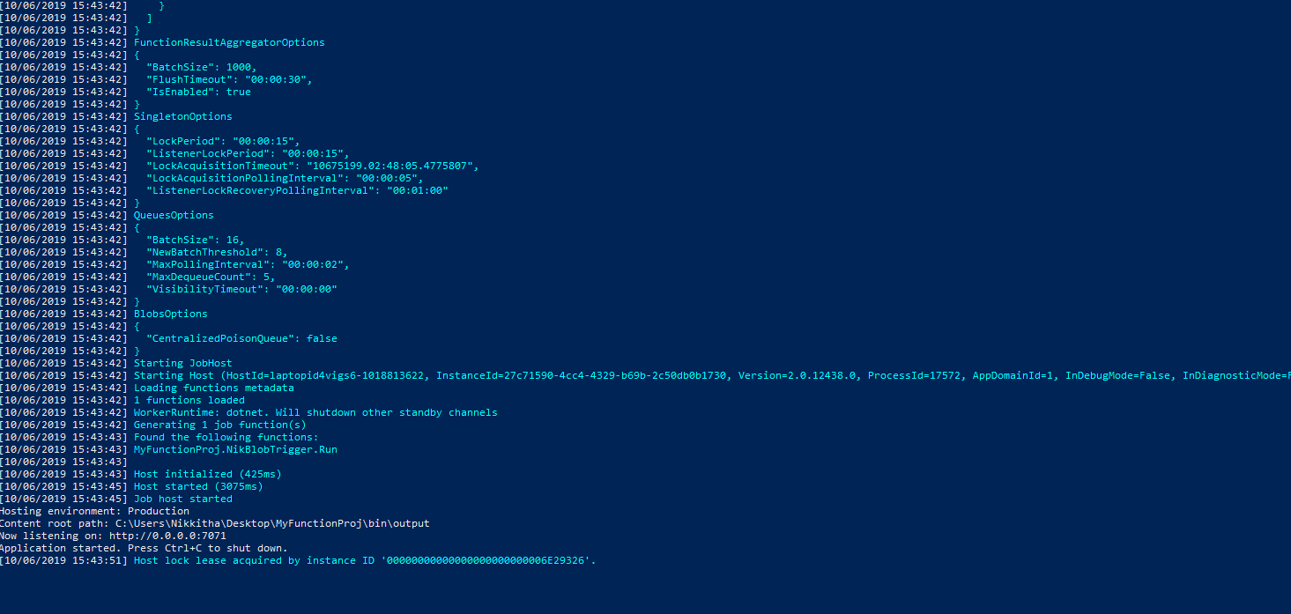
It says “now listening”, which means that the compilation was successful and it is now time to upload the files on Microsoft Azure Storage Explorer.

Slide 9
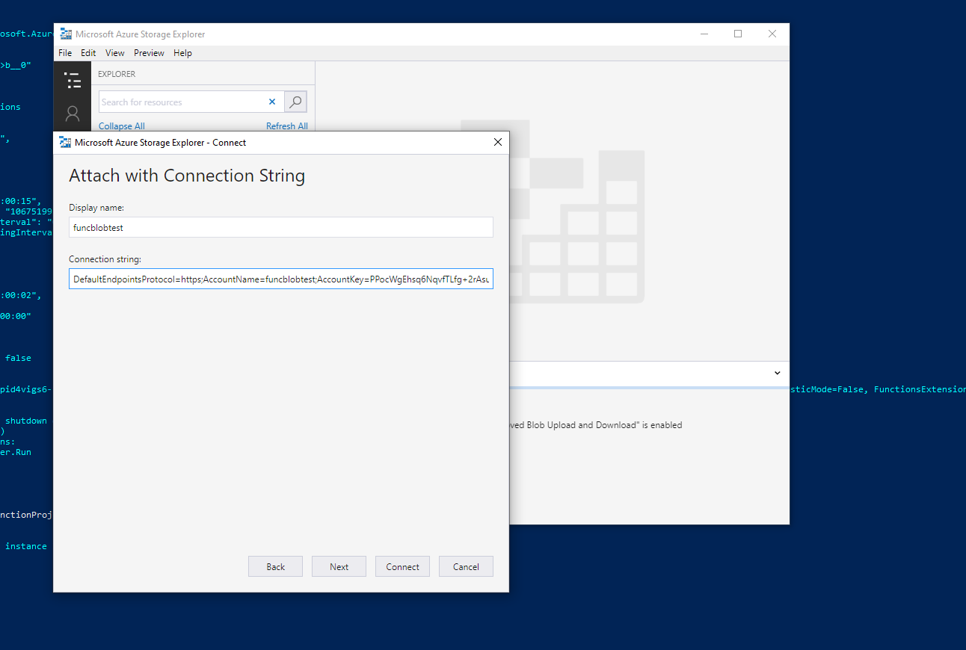
Enter the connection string to connect to the storage account.

Slide 10
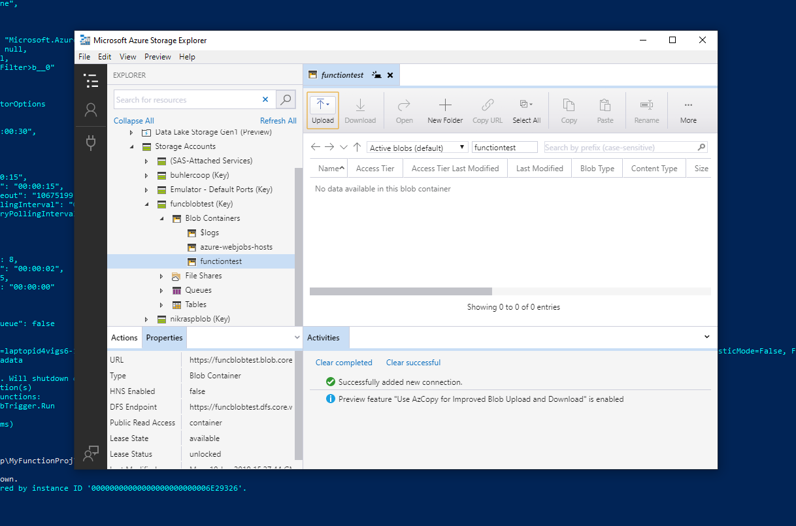
Upload a .txt file in the Microsoft Azure Storage Explorer.

Slide 11
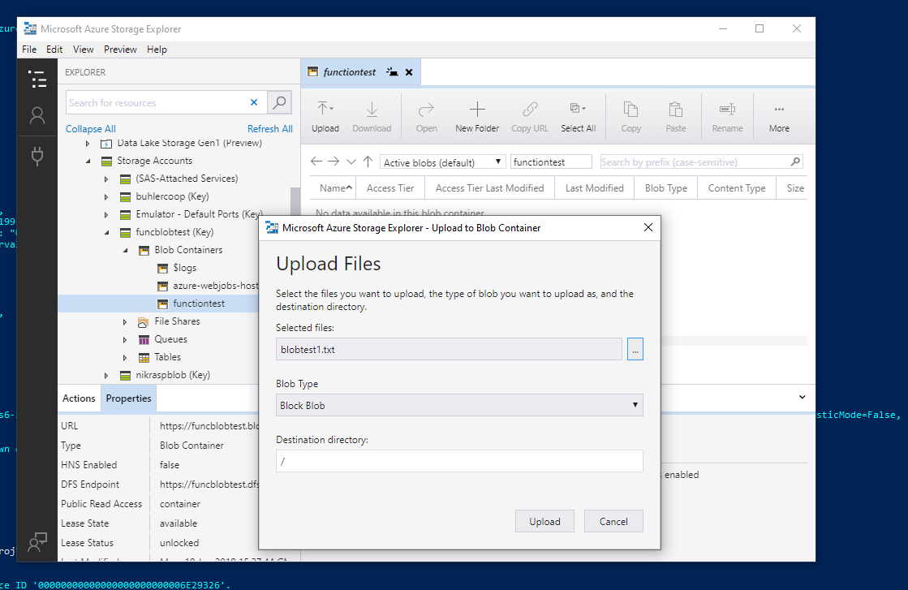
Select the file to be uploaded.

Slide 12
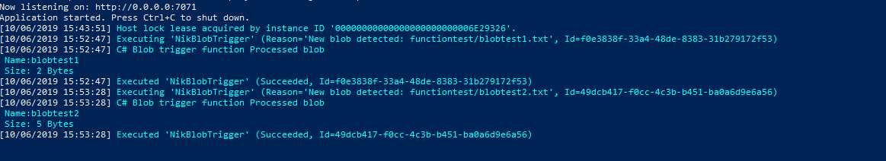
A new blob is detected as soon as a file is uploaded on the Storage Explorer.
As the mentioned file type was .txt, any other file type uploaded will not be detected here.

Slide 13
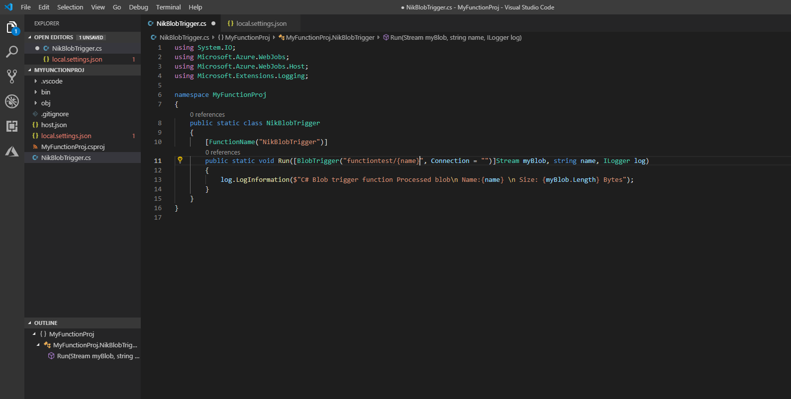
Any type of file can be updated, and to make sure it triggers, do not mention the file extension type.

Slide 14
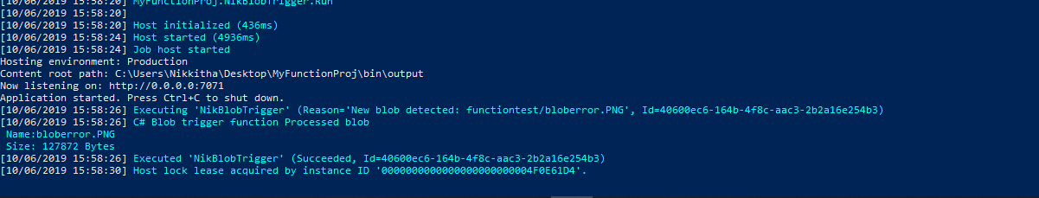
An image file with .png extension was uploaded, and the blob trigger was triggered.

Slide 15
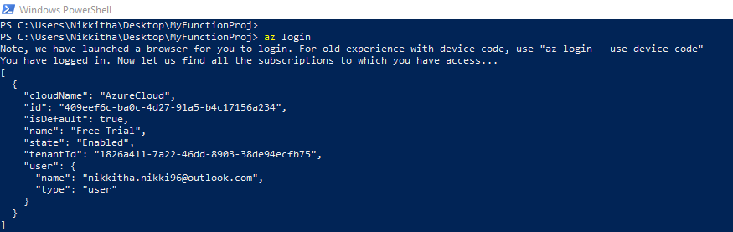
Logging in to Azure subscription via PowerShell using the azlogin command.
This will redirect to Microsoft account login page on a web browser.

Slide 16
Firstly create a resource group and a resource called “Function App” in the azure portal.
And then, update in the powershell.

Slide 17
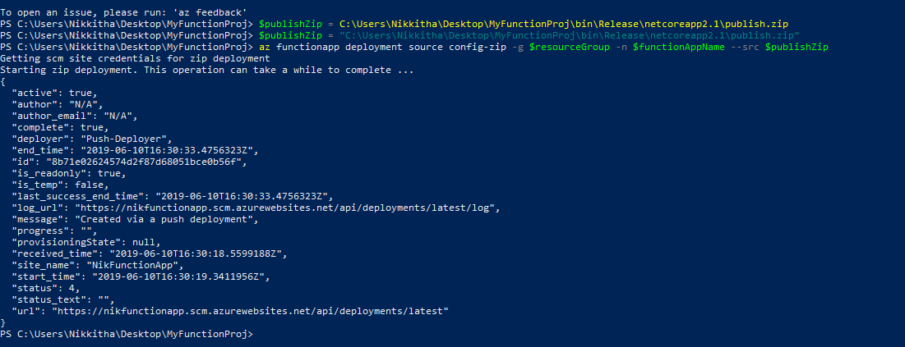
Zip the “publish” folder present inside the Function App created locally on the computer.

